Slide 1

STUDENT PERFORMANCE ANALYSIS
COURSE NAME – DATA MODELING AND VISUALIZATION
COURSE CODE – E1UA306B
PROGRAM NAME – BSC COMPUTER SCIENCE
SUBMITTED BY
GROUP MEMBER 1 – NISHA (24SCSE1550014)
GROUP MEMBER 2 – SANYA (24SCSE1550016)

Slide 2
INTRODUCTION
In today’s digital world, large amounts of educational data are generated every day. However, raw data in the form of tables and numbers is often difficult to understand. Data visualization plays a major role in converting this raw data into meaningful graphical forms such as bar charts and line charts.
Student performance analysis helps teachers and institutions evaluate academic progress, identify weak students, and improve teaching strategies. This project uses Python and Matplotlib to analyze student marks and visualize them effectively.
3. PROBLEM STATEMENT
Educational institutions store marks of students, but they are usually not analyzed visually. It becomes difficult to compare students, subjects, and overall performance trends. Hence, there is a need to design a system that can analyze student marks and represent them using bar graphs and charts for easy understanding.

Slide 3
OBJECTIVES
The main objectives of this project are:
1 To analyze student marks in multiple subjects
2 To visualize data using bar graphs and charts
3 To calculate average student performance
4 To compare subject-wise performance
5 To build a basic student performance analysis model
METHODOLOGY
1 The project is implemented using the following steps:
2 Data collection of student marks
3 Storing data using arrays/lists
4 Data processing using NumPy
5 Visualization using Matplotlib
6 Analysis of graphs and interpretation

Slide 4
SOFTWARE AND HARDWARE REQUIREMENTS
Software Requirements
1 Operating System: Windows / Linux / Mac
2 Programming Language: Python 3
3 Tools: Jupyter Notebook / VS Code
4 Libraries:
Matplotlib
NumPy
Pandas (optional)
Hardware Requirements
1 Minimum 4 GB RAM
2 Intel i3 or above
3 100 GB hard disk
4 Standard keyboard and mouse

Slide 5
DATASET DESCRIPTION
The dataset consists of marks of 5 students in 3 subjects:
Mathematics
Science
English
This dataset is used to visualize subject-wise and average performance.
SYSTEM DESIGN
Input:
Student marks
Process:
Store data
Calculate averages
Generate graphs
Output:
Bar graph of subject-wise marks
Line chart of average marks

Slide 6
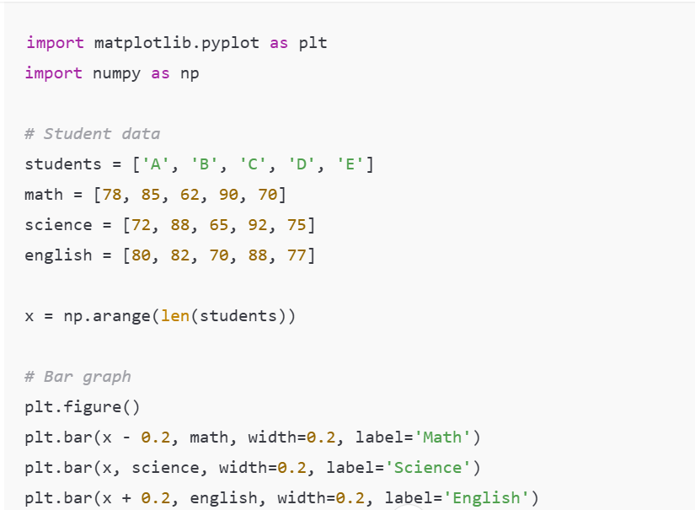
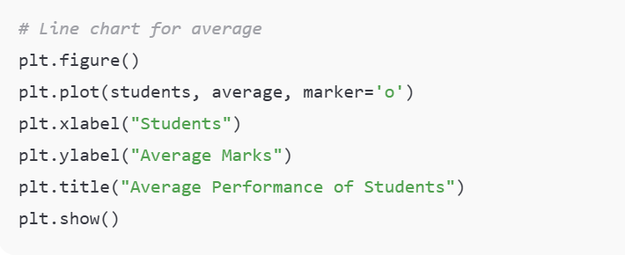
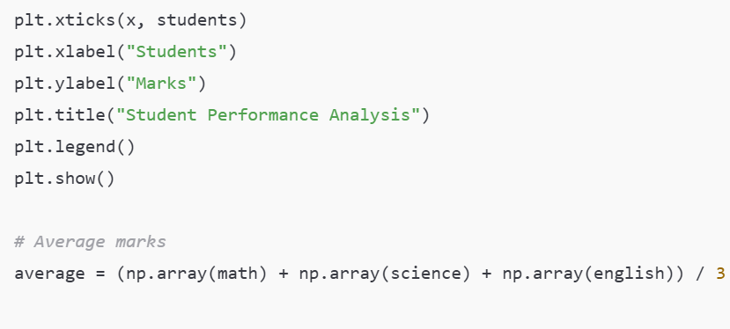

Slide 7
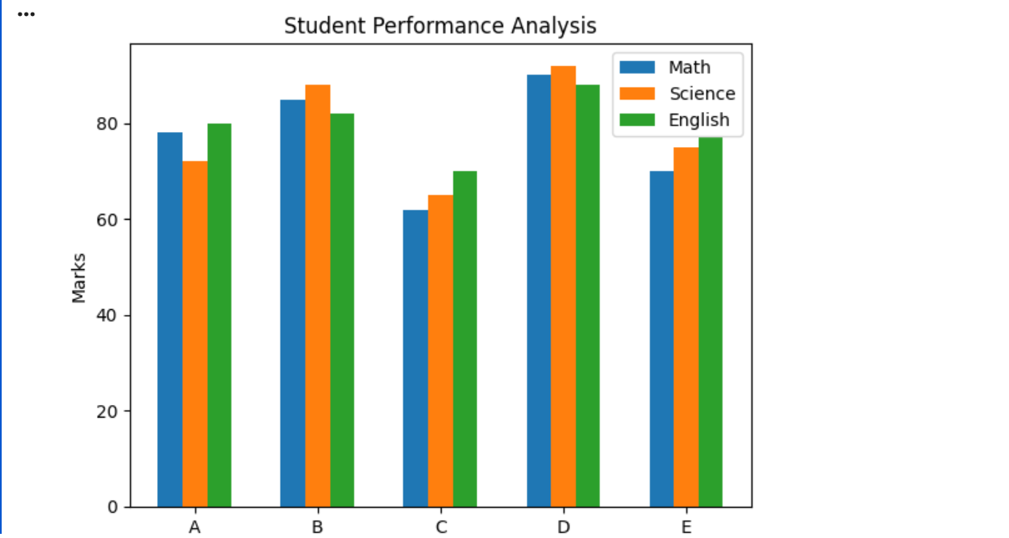
RESULTS AND OUTPUT
The system generates:
Bar chart showing performance in Math, Science, and English
Line chart showing average marks of students

Slide 8
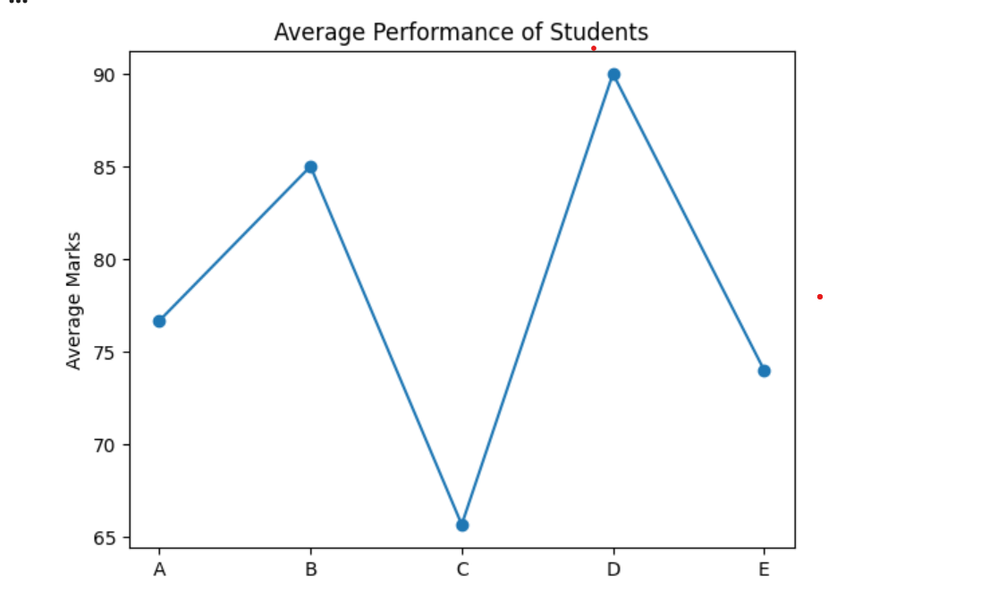
These outputs help in identifying:
Best performing students
Weak subjects
Overall academic trends

Slide 9
PERFORMANCE ANALYSIS
The model calculates:
Average marks of each student
Comparison between students
Performance patterns from graphs
This basic model can be further enhanced for prediction and classification.
LIMITATIONS
Small dataset
Manual data entry
No real-time updates
No advanced prediction model

Slide 10
CONCLUSION
The project successfully demonstrates how data visualization helps in analyzing student performance. Bar graphs and charts created using Matplotlib make the data easy to understand and interpret. This system can assist teachers and institutions in improving academic planning and decision-making.
BIBLIOGRAPHY
Python Official Documentation
Matplotlib Documentation
NumPy Documentation
Data Visualization Concepts – Study Materia

